Slide 1
Multi-Layer Feed Forward Networks
Develop a Feedforward neural for XOR Problem that takes two binary inputs, and simulate the logical operation of XOR
Develop a feedforward neural model for MNIST Digit classification

Slide 2
XOR Problem using FeedForward network

Slide 3
The linear separability of points
Linear separability of points is the ability to classify the data points in the hyperplane by avoiding the overlapping of the classes in the planes.
Each of the classes should fall above or below the separating line and then they are termed as linearly separable data points
Data points have to be linearly separable to eradicate the issues with wrong weight updation and wrong classifications

Slide 4
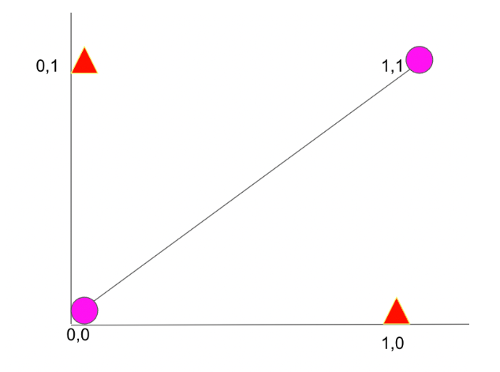
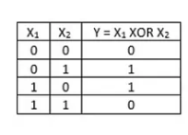
XOR Logic – truth table for XOR
linear separability of data points is not possible using the XOR logic.
In the above figure, we can see that above the linear separable line the red triangle is overlapping with the pink dot

Slide 5
The Neural Network Model for XOR Logic
The neural network needs to produce two different decision planes to linearly separate the input data based on the output patterns.
This is achieved by using the concept of hidden layers
The neural network will consist of one input layer with two nodes (X1,X2);
one hidden layer with two nodes (since two decision planes are needed);
and one output layer with one node (Y).
Hence, the XOR problem with neural networks can be solved using a neural network architecture with an input layer having two nodes, hidden layer with two nodes, and one output layer with one node.

Slide 6
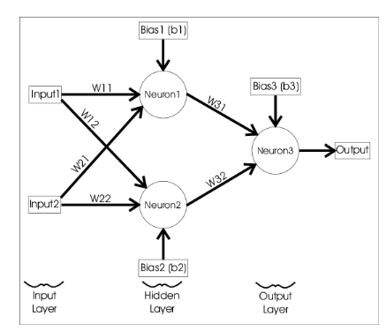
The Neural Network Model for XOR Logic

Slide 7

The Neural Network Model for XOR Logic
Define the neural network model
Find the total number of learnable parameters

Slide 8
The Neural Network Model for XOR Logic
Define the neural network model
Find the total number of learnable parameters = 6 weights + 3 biases= 9 parameters

Slide 9
Problem - Find the total number of learnable parameters
A neural network with 13 input neurons, two hidden layers of 5 and 4 neurons, and an output layer of 3 neurons.

Slide 10
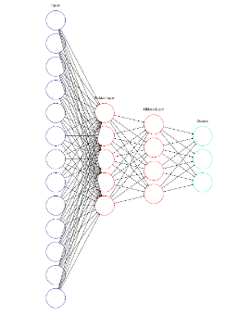
Find the total number of learnable parameters
The total number of weights is ( 13 * 5 ) + ( 5 * 4 ) + ( 4 * 3 ) = 97.
The total number of biases is 5 + 4 + 3 = 12.
Total number of parameters 97 + 12 = 109.
Note that input layer doesn’t have bias

Slide 11
Activation functions
These activation functions are non-linear functions (except for “identity”) which allow the neural network to learn non-linear relationships between the input and output data.
Each of the activation functions transforms values in different ways and will create different training processes, learned mappings, and output predictions in a neural network
So, training to see what creates the best result by changing activation functions

Slide 12
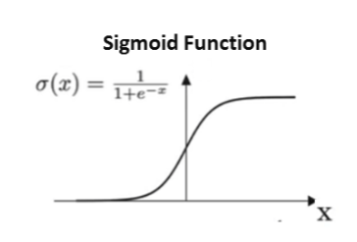
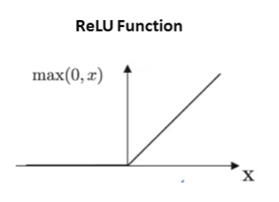
Sigmoid and ReLU
“Sigmoid” : uses the logistic sigmoid function, f(x) = 1 / (1 + exp(-x)) (the output will always range be greater than 0 and less than 1)
“ReLU” : uses the rectified linear unit function, f(x) = max(x,0) (the output will always be greater than or equal to 0)

Slide 13
THE LEARNING ALGORITHM
The information of a neural network is stored in the interconnections between the neurons i.e. the weights.
A neural network learns by updating its weights according to a learning algorithm that helps it converge to the expected output.
The learning algorithm is a principled way of changing the weights and biases based on the loss function.
1. Initialize the weights and biases randomly.
2. Iterate over the data
i. Compute the predicted output using the sigmoid function
ii. Compute the loss using the square error loss function
iii. W(new) = W(old) — α ∆W
iv. B(new) = B(old) — α ∆B
3. Repeat until the error is minimal
The algorithm divided into two parts: the forward pass and the backward pass also known as “backpropagation.”

Slide 14
Importing necessary Libraries
import torch
from matplotlib import pyplot as plt
from torch.utils.data import Dataset, DataLoader
import torch.nn as nn
import numpy as np
loss_list = []
torch.manual_seed(42)

Slide 15
Initialize inputs and expected outputs
Step 1: Initialize inputs and expected outputs as per the truth table of XOR
Create the tensors x1,x2 and y.
They are the training examples in the dataset for the XOR
X = torch.tensor([[0,0],[0,1],[1,0],[1,1]], dtype=torch.float32)
Y = torch.tensor([0,1,1,0], dtype=torch.float32)

Slide 16

Define XORModel class
Step 2: Define XORModel class - write constructor and forward function

Slide 17
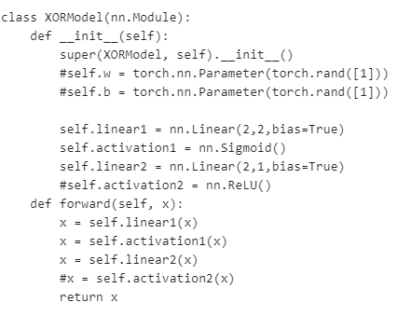
Define XORModel class
Step 2: Define XORModel as class

Slide 18
Define XORModel class
In PyTorch, neural networks are created by using Object Oriented Programming.
The layers are defined in the init function
Forward pass is defined in the forward function, which is invoked automatically when the class is called.
These Functions are possible because of the class nn.Module from torch which was inherited

Slide 19
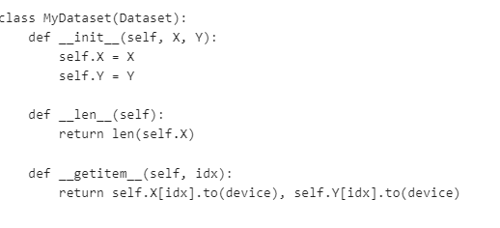
write Dataset class
Step 3: Create DataLoader. Write Dataset class with necessary constructors and methods – len() and getitem()
Create the dataset
full_dataset = MyDataset(X, Y)

Slide 20
Dataset and DataLoader
Dataset class in PyTorch covers the data in a tuple
Enables us to access the index of each data.
This is necessary to create dataloader class which can be used to shuffle, apply Mini-Batch Gradient Descent etc
The init function is used to initialise the x and y of our dataset
getitem function is used to return a particular index in the dataset. It returns both the x and y value.
len function returns the size of the dataset
DataLoader is used to perform mini batch or stochastic gradient descent by acting as an iterable

Slide 21
dataLoader and GPU loading
batch_size = 1
Create the dataloaders for reading data - # This provides a way to read the dataset in batches, also shuffle the data
train_data_loader = DataLoader(full_dataset, batch_size=batch_size, shuffle=True)
Find if CUDA is available to load the model and device on to the available device CPU/GPU
device = torch.device("cuda" if torch.cuda.is_available() else "cpu")
Load the model to GPU
model = XORModel().to(device)
print(model)

Slide 22
MSELoss Criterion and Optimizer
Add the criterion which is the MSELoss
loss_fn = torch.nn.MSELoss()
Optimizers specified in the torch.optim package
optimizer = torch.optim.SGD(model.parameters(), lr=0.03)

Slide 23
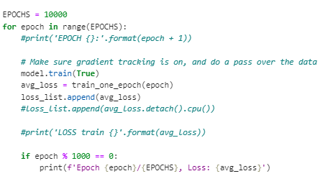
Training Loop
EPOCHS = 5000
for epoch in range(EPOCHS):
print('EPOCH {}:'.format(epoch + 1))
# Make sure gradient tracking is on, and do a pass over the data
model.train(True)
avg_loss = train_one_epoch(epoch)
loss_list.append(avg_loss.detach().cpu())
print('LOSS train {}'.format(avg_loss))

Slide 24
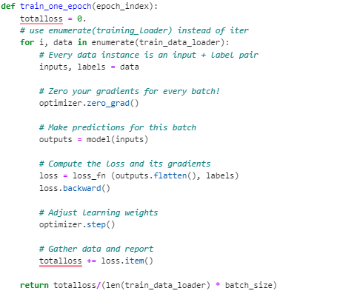
Training an epoch

Slide 25
Model Inference step
for param in model.named_parameters():
print(param)
Model inference – similar to prediction in ML
input = torch.tensor([0, 1], dtype=torch.float32).to(device)
model.eval()
print("The input is = {}".format(input))
print("Output y predicted ={}".format(model(input)))
#Display the plot
plt.plot(loss_list)
plt.show()

Slide 26
Output – Model parameters
Model parameters= ('linear1.weight', Parameter containing:
tensor([[ 0.5413, 0.5890],
[-0.1679, 0.6455]], requires_grad=True))
Model parameters= ('linear1.bias', Parameter containing:
tensor([-0.1505, 0.1357], requires_grad=True))
Model parameters= ('linear2.weight', Parameter containing:
tensor([[-0.3832, 0.3738]], requires_grad=True))
Model parameters= ('linear2.bias', Parameter containing:
tensor([0.5562], requires_grad=True))

Slide 27
Output- XOR model
XOR Model= XORModel(
(linear1): Linear(in_features=2, out_features=2, bias=True)
(activation1): Sigmoid()
(linear2): Linear(in_features=2, out_features=1, bias=True)
)
The input is = tensor([0., 1.])
Output y predicted =tensor([1.0000], grad_fn=<ViewBackward0>)

Slide 28
Outputs after applying round
#Model Inference
input = torch.tensor([0, 1], dtype=torch.float32).to(device)
model.eval()
print("The input is = {}".format(input))
print("Output y predicted ={}".format(model(input)))
inference_binary = torch.round(model(input))
print("inference-binary=", inference_binary)
test_inputs = torch.tensor([[0, 0], [0, 1], [1, 0], [1, 1]], dtype=torch.float32)
inference_binary_inputs = torch.round(model(test_inputs))
print("\nInference for test inputs:", model(test_inputs))
print("\nInference Binary for test inputs:",inference_binary_inputs )

Slide 29
Outputs after applying round
Inference for test inputs: tensor([[5.9605e-07],
[1.0000e+00],
[1.0000e+00],
[1.9073e-06]], grad_fn=<AddmmBackward0>)
Inference Binary for test inputs: tensor([[0.],
[1.],
[1.],
[0.]], grad_fn=<RoundBackward0>)

Slide 30
Final Result – Note the parameters for verification
XOR Model= XORModel(
(linear1): Linear(in_features=2, out_features=2, bias=True)
(activation1): Sigmoid()
(linear2): Linear(in_features=2, out_features=1, bias=True)
)
Epoch 0/10000, Loss: 0.3011328335851431
Epoch 1000/10000, Loss: 0.27038102224469185
Epoch 2000/10000, Loss: 0.27022556215524673
Epoch 3000/10000, Loss: 0.26847539842128754
Epoch 4000/10000, Loss: 0.26516808941960335
Epoch 5000/10000, Loss: 0.22409666888415813
Epoch 6000/10000, Loss: 0.00014026711960468674
Epoch 7000/10000, Loss: 1.1688428003253648e-11
Epoch 8000/10000, Loss: 3.240074875066057e-12
Epoch 9000/10000, Loss: 3.0810909379397344e-12
Model parameters= ('linear1.weight', Parameter containing:
tensor([[-1.9767, 2.0750],
[-3.0809, 3.3435]], requires_grad=True))
Model parameters= ('linear1.bias', Parameter containing:
tensor([ 0.7012, -2.5002], requires_grad=True))
Model parameters= ('linear2.weight', Parameter containing:
tensor([[-2.6653, 2.7713]], requires_grad=True))
Model parameters= ('linear2.bias', Parameter containing:
tensor([1.5715], requires_grad=True))
The input is = tensor([0., 1.])
Output y predicted =tensor([1.0000], grad_fn=<ViewBackward0>)

Slide 31
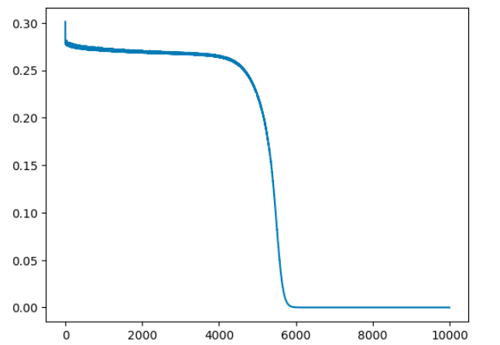
Final Result

Slide 32
Verification –Same parameter values taken from the output
import torch
weight1= torch.tensor([[-1.9767, 2.0750],[-3.0809, 3.3435]])
bias1= torch.tensor([ 0.7012, -2.5002])
weight2 = torch.tensor([[-2.6653, 2.7713]])
bias2=torch.tensor([1.5715])
X = torch.tensor([[0,0],[0,1],[1,0],[1,1]], dtype=torch.float32)
Y = torch.tensor([0,1,1,0], dtype=torch.float32)
result= torch.mm(X, weight1.t())+bias1
Sigm = torch.nn.Sigmoid()
sg_result = Sigm(result)
final_result= torch.mm(sg_result, weight2.t())+bias2
print(final_result)
Use directly model.linear1.weight, model.linear1.bias, model.linear2.weight, model.linear2. bias

Slide 33
Verification –Same parameter values taken from the output
import torch
weight1= torch.tensor([[-1.9767, 2.0750],[-3.0809, 3.3435]])
bias1= torch.tensor([ 0.7012, -2.5002])
weight2 = torch.tensor([[-2.6653, 2.7713]])
bias2=torch.tensor([1.5715])
X = torch.tensor([[0,0],[0,1],[1,0],[1,1]], dtype=torch.float32)
Y = torch.tensor([0,1,1,0], dtype=torch.float32)
result= torch.mm(X, weight1.t())+bias1
Sigm = torch.nn.Sigmoid()
sg_result = Sigm(result)
final_result= torch.mm(sg_result, weight2.t())+bias2
print(final_result)
tensor([[5.7220e-05],
[1.0000e+00],
[1.0000e+00],
[1.7166e-05]])

Slide 34
Problem 2 - Feedforward neural model for MNIST Digit classification

Slide 35
Feedforward neural model for MNIST Digit classification
A popular demonstration of the capability of deep learning techniques is object recognition in image data.
The MNIST Handwritten Digit Recognition Problem
The MNIST dataset was developed by Yann LeCun, Corinna Cortes, and Christopher Burges for evaluating machine learning models on the handwritten digit classification problem.
The dataset was constructed from a number of scanned document datasets available from the National Institute of Standards and Technology (NIST).
This is where the name for the dataset comes from, the Modified NIST or MNIST dataset.
Images of digits were taken from a variety of scanned documents, normalized in size, and centered.
This makes it an excellent dataset for evaluating models, to focus on minimal data cleaning or preparation

Slide 36
Feedforward neural model for MNIST Digit classification
Baseline Model with feed-forward networks
We can use a complex model like a convolutional neural network to get the best results with MNIST
The MNIST dataset, also known as the Modified National Institute of Standards and Technology dataset, consists of a total of 70,000 images, the training set having 60,000 and the test set has 10,000.
This means that there are 10 classes of digits, which includes the labels for the numbers 0 to 9.
This dataset is mainly used for text classification using deep learning models.
Each image is a 28×28-pixel square (flattening this into a one-dimensional array results in 784 pixels total) in grayscale.

Slide 37
Feedforward neural model for MNIST Digit classification
The output targets are labels in the form of integers from 0 to 9.
This is a multiclass classification problem.
So use the cross entropy function to evaluate the model performance

Slide 38
Feedforward neural model for MNIST Digit classification
Step 1- Importing necessary libraries
The torchvision library provides specialized functions for computer vision tasks.
The dataset is downloaded the first time this function is called and stored locally, so no need to download again in the future
import torch
from torch.utils.data import Dataset, DataLoader
import torch.nn as nn
import matplotlib.pyplot as plt
import torchvision.datasets as datasets
from torchvision.transforms import ToTensor

Slide 39
Feedforward neural model for MNIST Digit classification
Step 2 - Loading the MNIST Dataset in PyTorch
#Create the dataset
mnist_trainset = datasets.MNIST(root='./data', train=True, download=True, transform = ToTensor())
mnist_testset = datasets.MNIST(root='./data', train=False, download=True, transform = ToTensor())
Note: Check the folder titled “data” under the current working directory for the downloaded dataset

Slide 40
Transform - ToTensor
transforms.ToTensor()
converts the image into numbers, that are understandable by the system.
It separates the image into three color channels (separate images): red, green & blue (note: MNIST data set is grayscale image)
Then it converts the pixels of each image to the brightness of their color between 0 and 255.
These values are then scaled down to a range between 0 and 1
The image is now a Torch Tensor

Slide 41
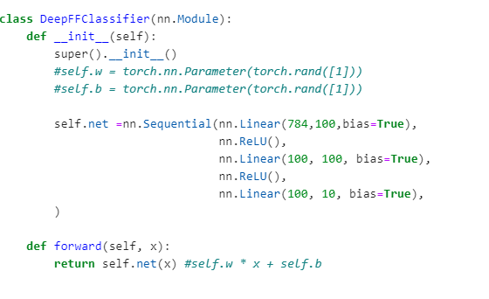
Feedforward neural model for MNIST Digit classification
Step 3 - Define Network model

Slide 42
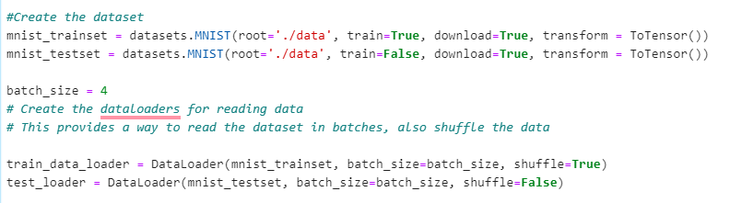
Feedforward neural model for MNIST Digit classification
Step 4 - Create dataset and dataloader

Slide 43
Feedforward neural model for MNIST Digit classification
So, dataset is downloaded, shuffled and transformed to tensors
Now, load them to DataLoader, which combines the data-set and a sampler and provides single or multi-process iterators over the data-set
batch size is the number of images to read in one go
Here batch_size = 4

Slide 44
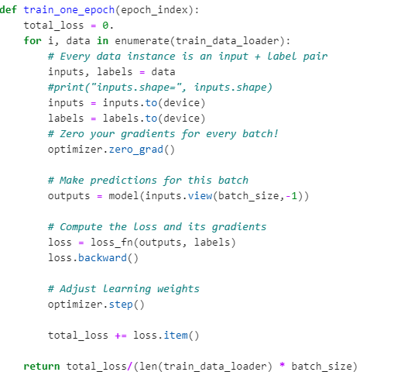
Training within an epoch
Step 5- Training within an epoch
len(train_data_loader)=60,000/4=15,000
batch_size=4
len(train_data_loader) * batch_size = 15,000*4=60,000

Slide 45
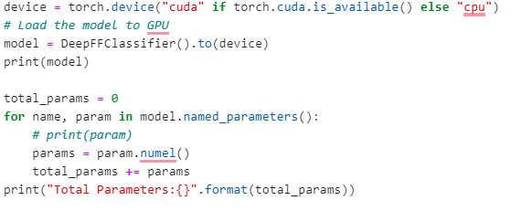
Feedforward neural model for MNIST Digit classification
Step 6 - Find the total number of parameters

Slide 46
Feedforward neural model for MNIST Digit classification - Output
DeepFFClassifier(
(net): Sequential(
(0): Linear(in_features=784, out_features=100, bias=True)
(1): ReLU()
(2): Linear(in_features=100, out_features=100, bias=True)
(3): ReLU()
(4): Linear(in_features=100, out_features=10, bias=True)
)
)
Total Parameters:89610

Slide 47
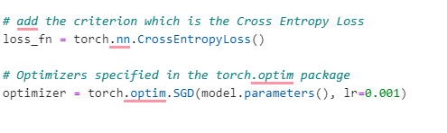
Feedforward neural model for MNIST Digit classification
Step 7 – Cross entropy loss as criterion and SGD Optimizer

Slide 48
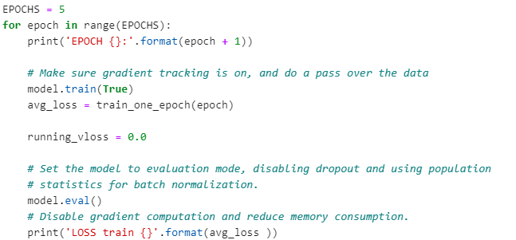
Training Loop
Step 8 – Training loop

Slide 49

Display
Step 9 – display an image

Slide 50
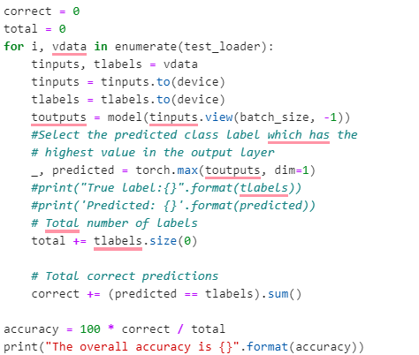
Compute Accuracy
Step 10 – Accuracy

Slide 51
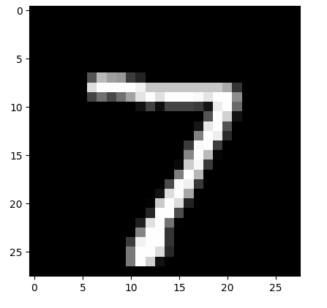
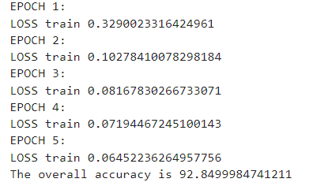
Output

